Slide 1

MIS6380.003-DATA VISUALIZATION
B-Safe App
Safety First, Last and Always
DIVYA SUDHAKAR

Slide 2
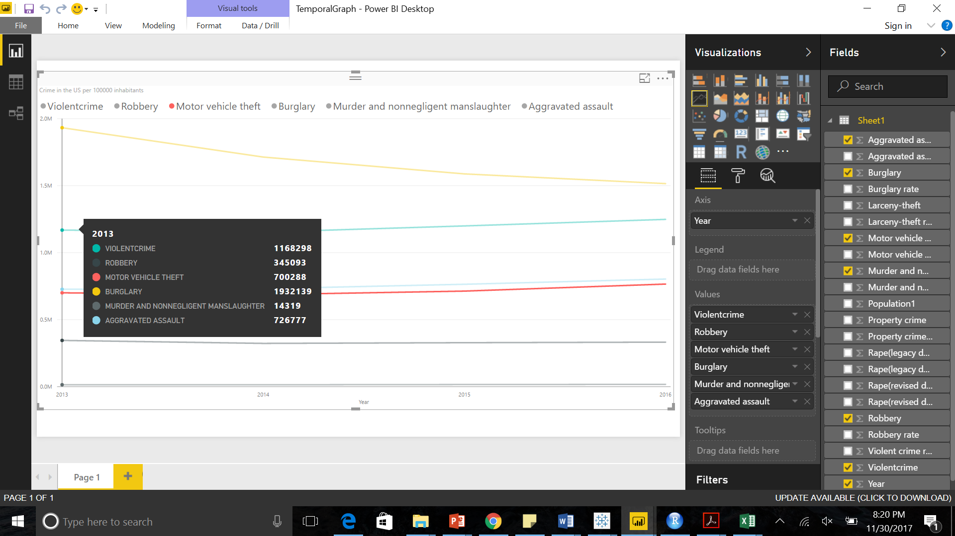
CRIME Statistics PER 100,000 Inhabitants in the USA (2013-2016)
Notes:
Observation :This temporal graph depicts that crimes throughout the US decreased between 2013 and 2014 but after 2014 , there has been an increase in number of crimes.
MARKET OPPORTUNITY :The necessity to curb crime .

Slide 3
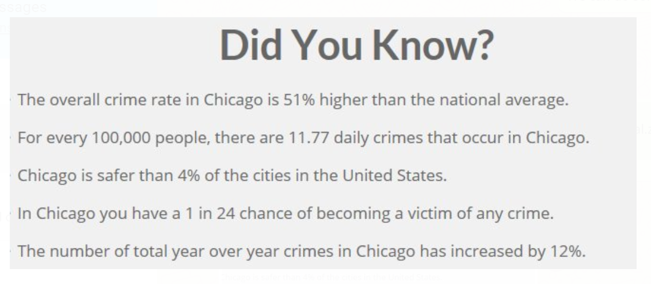
FACTS ABOUT CRIME IN CHICAGO

Slide 4
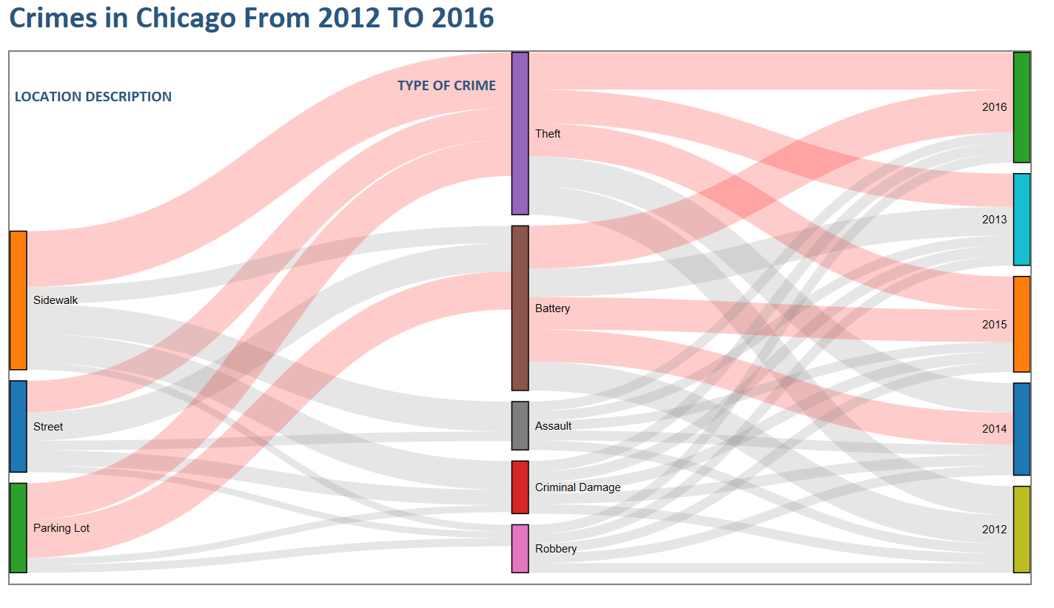
CRIMEs IN CHICAGO FROM 2012-2016
Notes:
Analysis: This Sankey graph shows the top 5 crime types and the location where these crimes occur frequently. It is evident that crime is steadily increasing from 2012 to 2016.The most common crimes are theft and battery .
Market opportunity: There is a necessity to warn and provide awareness to users using
1)Sidewalks
2)Street
3)Parking Lot

Slide 5
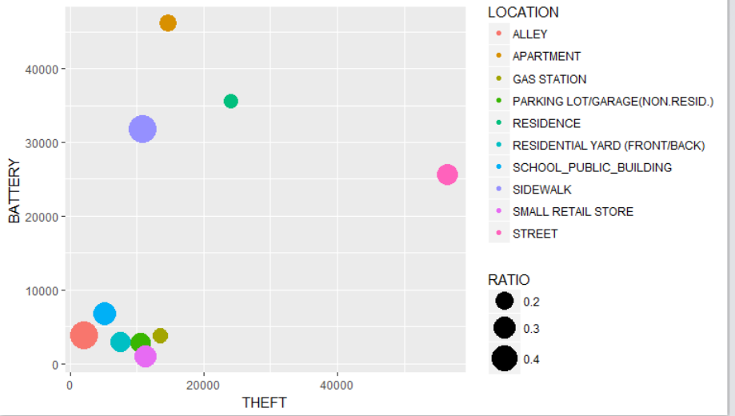
RATIO OF ARRESTS TO number of crime INCIDENTS
Notes:
This plot shows the ratio of total number of arrests to total number of incidents for different location types. X and Y axes represent the top 2 type of crimes. Battery and theft crimes happen the most.

Slide 6
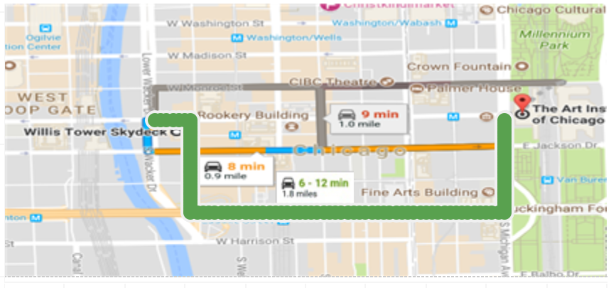
BUSINESS solution : suggest SAFEST ROUTE
Notes:
Business Proposal :The spatial graph shows how Bsafe app provides the fastest route ,safest route and optional route to users thereby warning them and keeping them aware of crime prone areas and rerouting them through alternate safes routes .

Slide 7
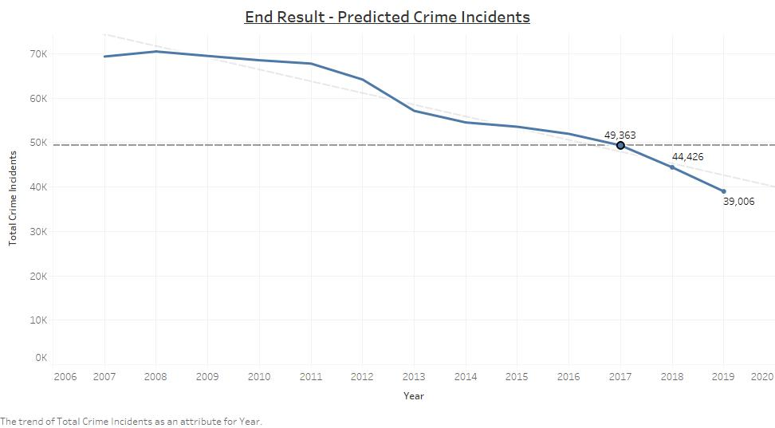
PREDICTED decrease in CRIME INCIDENTS
Notes:
We have predicted that the crimes in Chicago decrease by 10% in 2018 and further decrease by another 10% in 2019, if people make use of the services provided by our app. This is based on the assumption that similar decrease in crime rates have been found in the cities where such technology is being used.

Slide 8
Why invest?
Chicago is one of the cities in the US with high crime rates
Crime rates are on the rise in the city which is making people, neighborhoods, the tourists vulnerable to incidents of crime
The main purpose of this business idea is to ensure the people of Chicago are less exposed to crimes by suggesting safer routes to users whenever they intend to travel through a high crime-rate area
This app will help people know about the suspicious activity in and around their area and will keep the travelers well informed as to where and which route is safe for them to travel
Opportunity to expand to other cities in the US

Slide 9
REFERENCES
https://ucr.fbi.gov/crime-in-the-u.s/2016/crime-in-the-u.s.-2016/tables/table-1
http://www.areavibes.com/chicago-il/crime/
http://www.city-data.com/crime/crime-Chicago-Illinois.html
https://www.kaggle.com/currie32/crimes-in-chicago
http://www.ucrdatatool.gov
https://www.theatlantic.com/national/archive/2015/02/more-police-managed-more-effectively-really-can-reduce-crime/385390/

